Slide 1
Women in Technology and Software Engineering Club
Sign-in here: https://bit.ly/32aWV4m

Slide 2
Hack the Hackathon Agenda
What is a hackathon?
What do I need to bring?
Do I need to know how to code?
Where are some resources for me?
How do I Git into it?
Questions

Slide 3
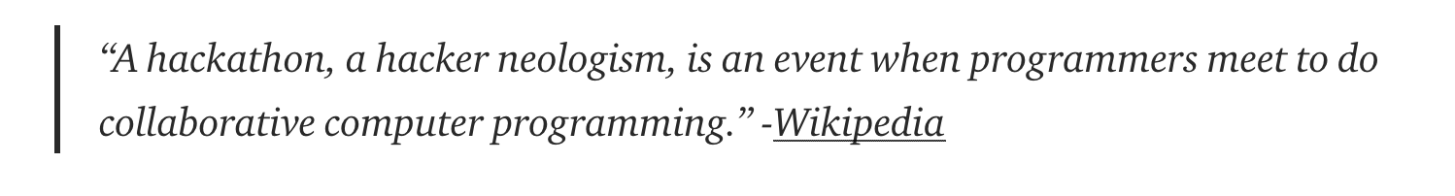
What is a hackathon?
Hackathons provide a venue
You can work on whatever project you want or you can just go for the talks!
They usually have mentors which are super helpful in guiding you in the right direction. They are usually upperclassmen or graduate students or sometimes full time software engineers.

Slide 4

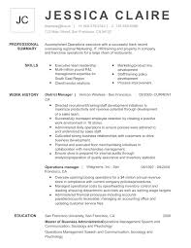









What should I bring?

Slide 5
Do I need to know how to code?

Slide 6
Do I need to know how to code?
NO.
You just need to want to learn!

Slide 7
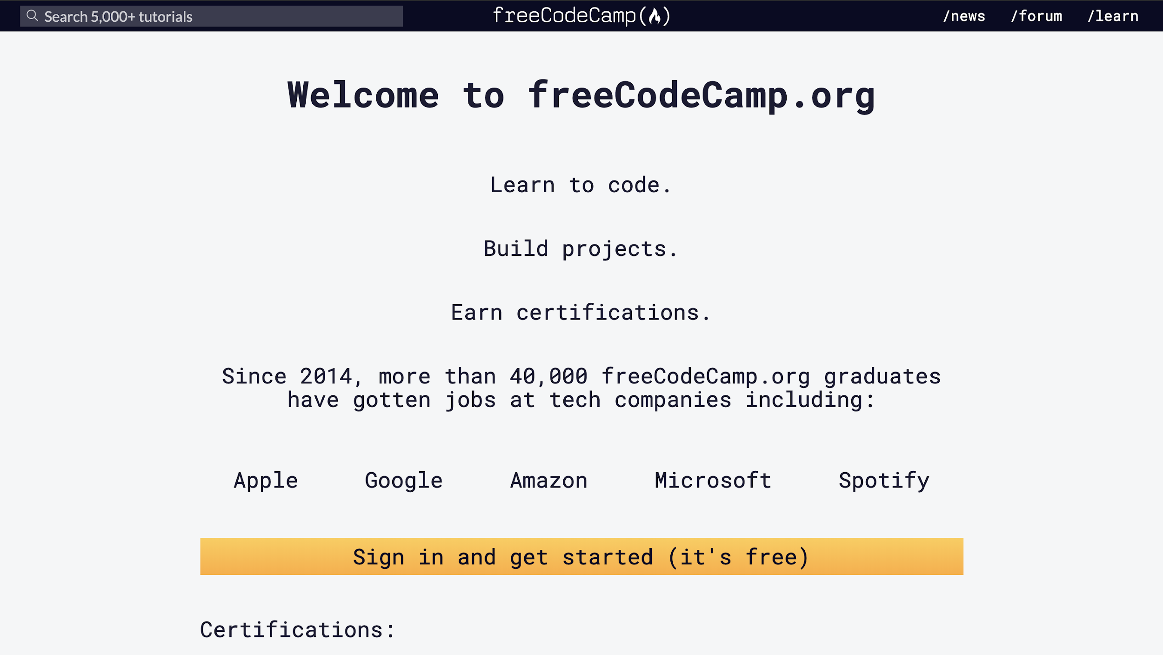
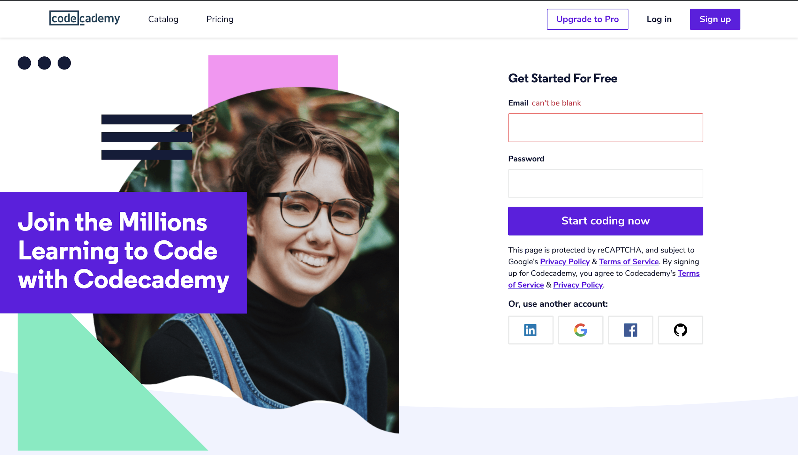
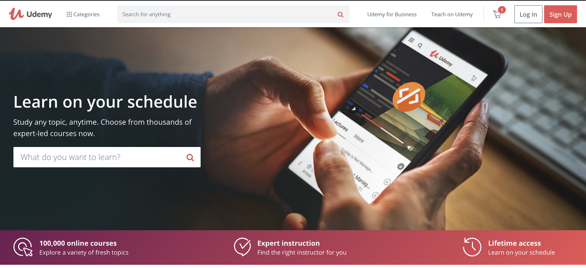
Resources for new coders
https://www.freecodecamp.org/ https://www.codecademy.com/ https://www.udemy.com/

Slide 8
Let’s Git into it

